Slide 1

Biological Signal Processing for Cardiovascular Risk Stratification presenter name :mohamed halawa

Slide 2

Abstract
Cardiovascular diseases remain a leading cause of morbidity and mortality worldwide, necessitating innovative approaches for early risk stratification and intervention
In pursuit of this goal, we present a research project that merges biological signal processing with cutting-edge machine learning techniques
Our primary objective is to discriminate between healthy and at-risk individuals by analyzing continuous blood pressure recordings

Slide 3
Introduction
Cardiovascular diseases continue to be a leading cause of mortality and morbidity worldwide
Early risk stratification and intervention are crucial to improving patient outcomes and reducing the burden of CVDs
To address this challenge, we embark on a research journey that combines the power of biological signal processing and Deep learning to develop a novel approach for cardiovascular risk stratification
Several critical steps, including architecture selection, hyperparameter tuning, and addressing overfitting, are augmentation techniques are explored to diversify the dataset, promoting the generalization of the model to real-world scenarios

Slide 4
Problem Statement
Cardiovascular diseases (CVDs) remain a significant global health challenge, necessitating effective early risk stratification and intervention. Current methods for assessing cardiovascular risk encounter limitations in providing precise and individualized predictions. To address this, our research integrates biological signal processing and machine learning to pioneer a novel approach for cardiovascular risk stratification. The primary challenge lies in developing a model capable of processing complex biological signals, like electrocardiograms (ECG), and ensuring robust generalization to real-world clinical scenarios. The goal is to transcend existing limitations, offering a more accurate, personalized, and applicable tool for cardiovascular risk assessment. This research is driven by the urgent need to transform current methodologies and improve patient outcomes in the face of cardiovascular diseases.

Slide 5

Project steps

Slide 6
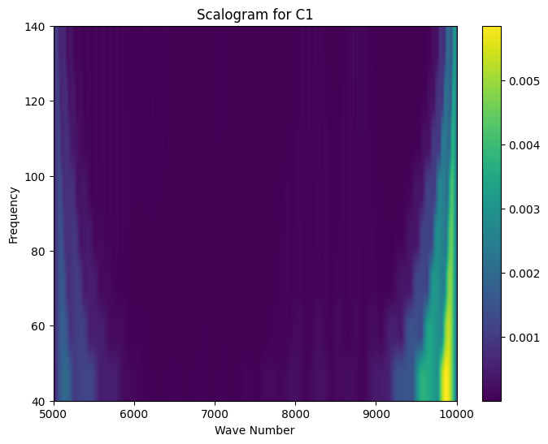
1.Slicing spectrograms
These techniques are instrumental in our journey to unravel the complexities of time-series data and to glean insights into the behavior of specific frequencies within intricate signals
Data Representation with Wavelet Transform: The Versatile Wavelet Transform: The Wavelet Transform, an indispensable mathematical tool, serves as the backbone of our data analysis
Wavelet Transform on Each Data Point: An inherent strength of the Wavelet Transform lies in its applicability to individual data points within a signal

Slide 7

Mathematical Equation for Wavelet Transform
The cornerstone of Wavelet Transform, the Continuous Wavelet Transform , is governed by the following mathematical equation: Here's a detailed breakdown of the equation components: CWT(a
The choice of wavelet function influences the scale and characteristics of the analysis
a and b: These parameters play a pivotal role in shaping the analysis by determining the time and frequency ranges for each analysis window

Slide 8
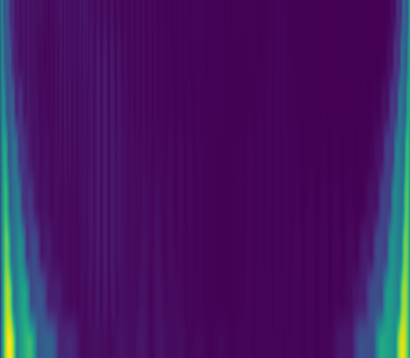
2.Cropping all Spectrograms
In conjunction with the previously outlined techniques of slicing spectrograms and employing the Wavelet Transform, the process of cropping spectrograms emerges as an essential component of our data preprocessing pipeline
The task of cropping is a dynamic and strategic maneuver that empowers us to zero in on specific regions of interest within the spectrograms
Cropping Techniques: Cropping spectrograms encompasses the meticulous selection and retention of specific regions within each spectrogram

Slide 9
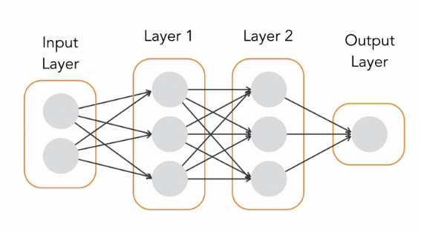
3.Model CNN

Slide 10
Input Layer
IMAGE_HEIGHT is the height of the scalograms
IMAGE_WIDTH is the width of the scalograms
N_CHANNELS is the number of channels in the scalograms

Slide 11

Convolutional Layers
Conv2D
This layer has 32 filters, each with a kernel size of 3x
The strides parameter is set to 2, which means that the output feature maps will be half the size of the input feature maps
The padding parameter is set to 'same', which means that the output feature maps will be the same size as the input feature maps
The activation function is ReLU, which is a nonlinear function that introduces nonlinearities into the model
Conv2D
This layer has 64 filters, each with a kernel size of 3x
The padding parameter is set to 'same', which means that the output feature maps will be the same size as the input feature maps
The activation function is ReLU
Conv2D

Slide 12
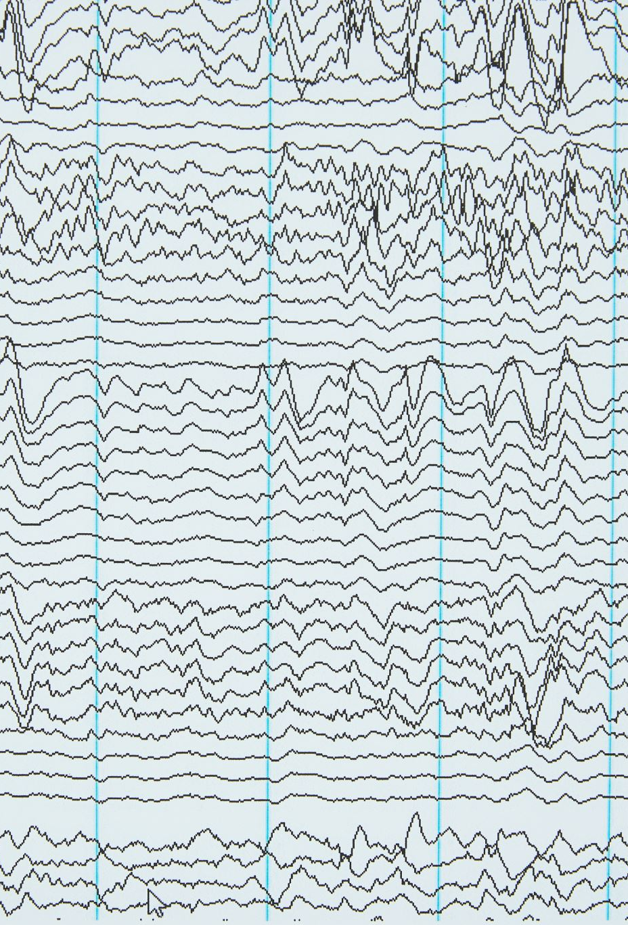
Convolutional Layers
This layer has 128 filters, each with a kernel size of 3x
The padding parameter is set to 'same', which means that the output feature maps will be the same size as the input feature maps
The activation function is ReLU

Slide 13
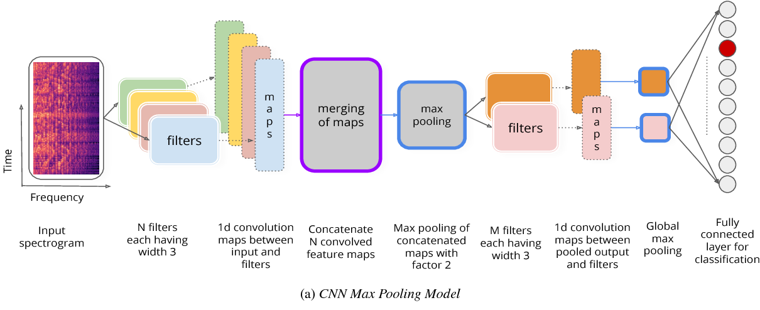
Pooling Layers
MaxPooling2D )
This layer applies max pooling with a pool size of 2x
Max pooling reduces the size of the feature maps by taking the maximum value within each 2x2 window
MaxPooling2D )
This layer applies max pooling with a pool size of 2x
MaxPooling2D )
This layer applies max pooling with a pool size of 2x

Slide 14

Batch Normalization
BatchNormalization
BatchNormalization
BatchNormalization
BatchNormalization
BatchNormalization
BatchNormalization

Slide 15
Fully Connected Layer
Dense
This layer has 256 neurons
The activation function is ReLU
Dense
This layer has N_CLASSES neurons, where N_CLASSES is the number of classes that the model is trained to classify
The activation function is softmax, which normalizes the output of the layer so that the values sum to

Slide 16
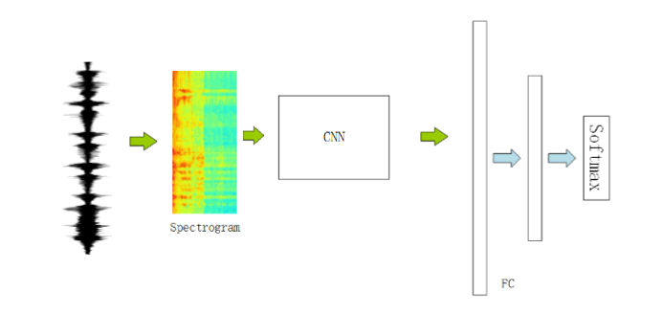
Output Layer
The output layer produces the classification probabilities for each class
The provided architecture uses a softmax activation function for the output layer, which means that the output of the layer is a probability distribution over the N_CLASSES classes

Slide 17
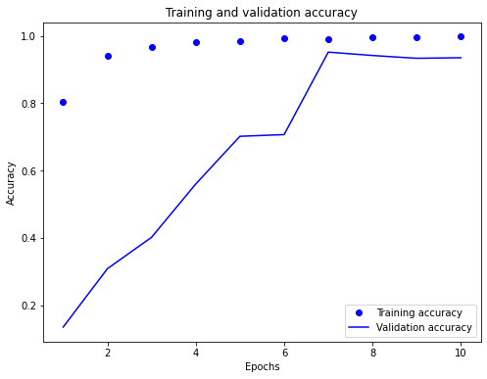
Training and validation accuracy

Slide 18
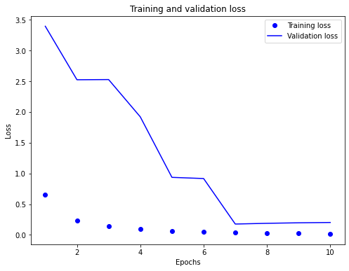
Training and validation loss

Slide 19
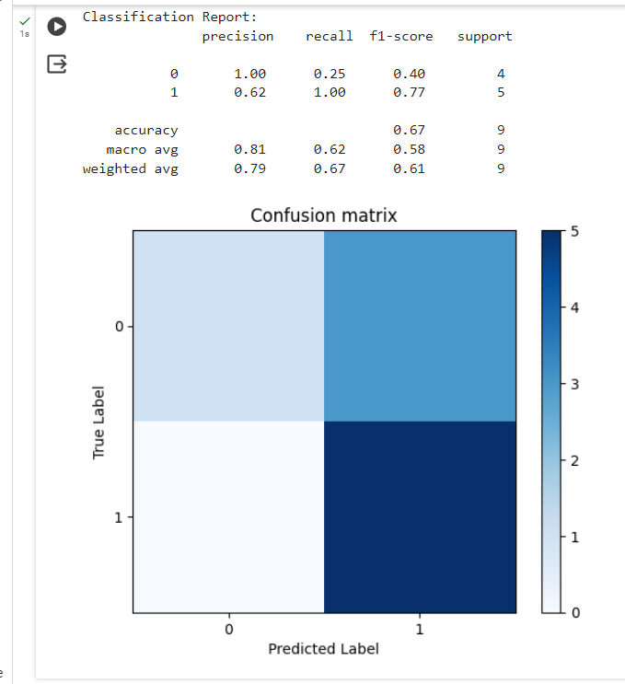
Confusion matrix

